Slide 1

Capstone Project -1 Exploratory Data Analysis
Hotel Booking Analysis
Yaswanth Kumar Donthuboyina

Slide 2
Contents:
Introduction
Problem statement
Data Exploration
Variable Description
Data Cleaning
EDA
Conclusion

Slide 3
Introduction:
Hotel booking analysis can provide valuable insights into factors such as occupancy rates, room pricing, length of stay, customer demographics, booking channels, and customer reviews. By analyzing these metrics, hotel managers can identify opportunities to increase revenue, improve guest satisfaction, and make more informed decisions about inventory management, staffing, and marketing efforts.

Slide 4
Problem Statement:
To identify and analyse the various factors that affect hotel booking, such as lead time, seasonality, hotel type, room type, booking channel, customer type, and other related variables, and to gain insights into the positive and negative business impact of these factors, in order to provide actionable recommendations for improving hotel booking rates, occupancy rates and revenue management strategies.

Slide 5
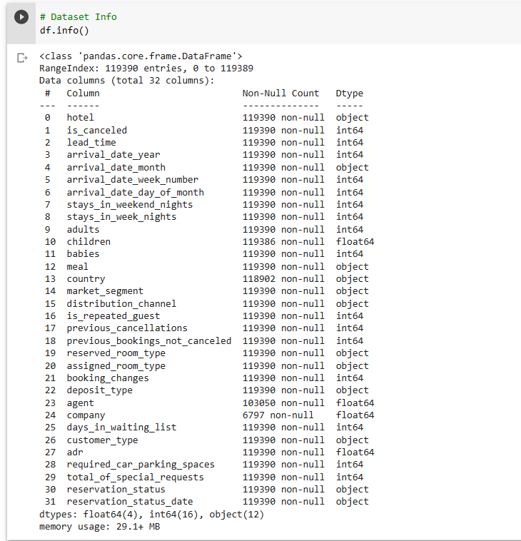
Data Exploration:
'df.info()' is a method used in Python's Pandas library to display a summary of a DataFrame's structure and content, including the number of rows and columns, the data type of each column, and the number of non-null values.

Slide 6
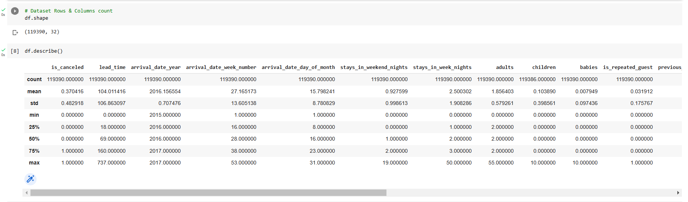
The hotel booking analysis dataset has 119390 rows and 32 columns

Slide 7
Variable Description:
Hotel : Types of hotel (City or Resort)
is_canceled : If the booking is cancelled 1 or else 0
lead_time : The number of days between when a customer makes a reservation and their actual arrival
arrival_date_year : Arrival year
arrival_date_month : Month of arrival
arrival_date_week_number : Week number of year
arrival_date_day_of_month : date of arrival
stays_in_weekend_nights : Number of weekend nights(saturday or sunday) guests stayed at hotel
stays_in_week_nights : Number of week nights guests stayed at hotel
adults : Number of adults stayed at hotel
children : Number of children stayed at hotel
babies : number of babies stayed at hotel
meal : Type of meal plan booked
country : Country of the guest/guests
market_segment : the process of grouping hotel guests into categories based on their booking patterns and travel habits.
distribution_channel : Type of booking distribution channel

Slide 8
is_repeated_guest : If repeated guest(1) or else (0)
previous_cancellations : Number of bookings cancelled by guest
previous_bookings_not_canceled : Number of successful bookings
reserved_room_type : Room type reserved by guest
assigned_room_type : Actual room assigned to guest
booking_changes : Number of changes made to booking
deposit_type : Type of deposit made by guest
agent : ID of Travel agent who made the booking
company : ID of compant that made the booking
days_in_waiting_list : Number of days the booking was in waiting list
customer_type : Type of the customer
adr : Average daily rate
required_car_parking_spaces : Number of car parking spaces required by the guest
total_of_special_requests : Number of special requests made by guest
reservation_status : Status of the Reservation
reservation_status_date : Check-Out Date

Slide 9
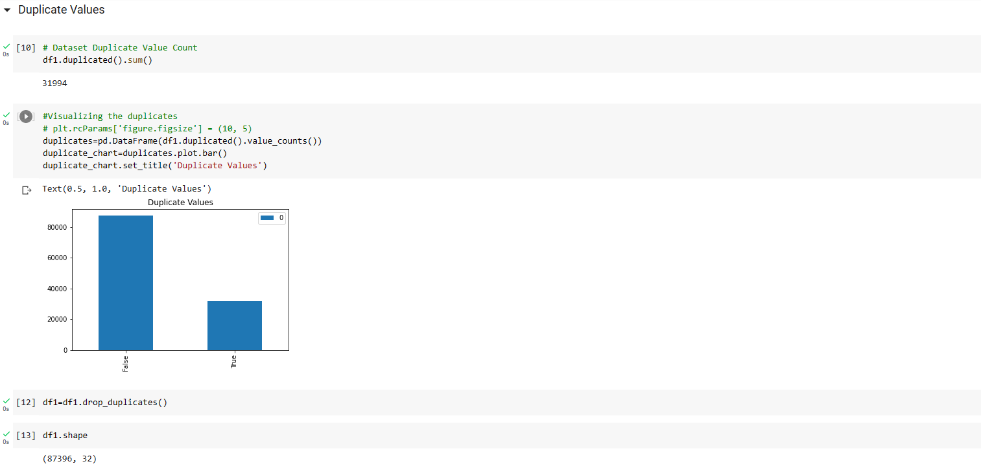
Data Wrangling: Removing Duplicate Values
After removing the duplicate values the shape of the database is (87396,32).

Slide 10

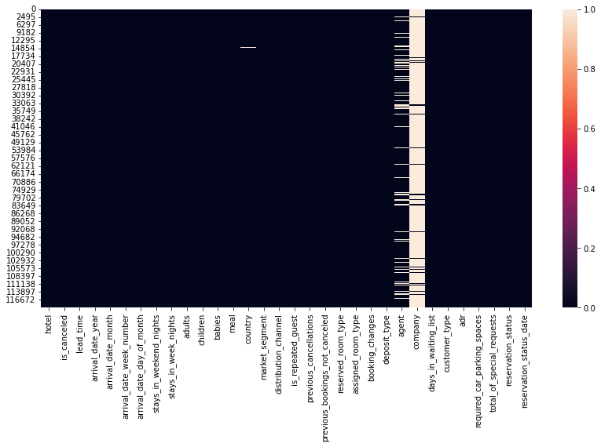
Data Cleaning: Visualizing Null Values
Here we have used heatmap to visualize the null values.
There are 4 columns in dataset which have missing values(null or Nan Values) and those columns are company, agent, country and children.

Slide 11
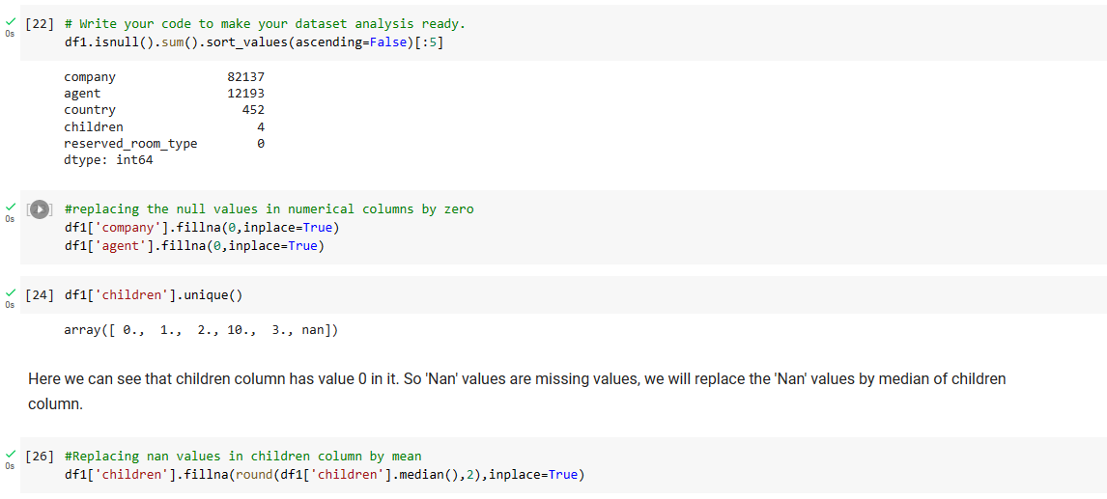
Data Wrangling: Treating Null Values
Here we have changed null values in numerical columns to 0.
As children column is already having values it is clear that null values in children column are missing values, so we have replaced the null values with median.

Slide 12
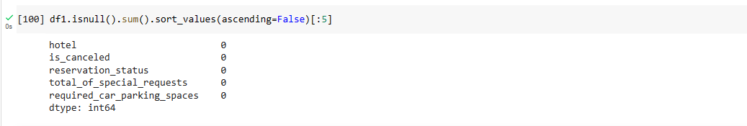
As country column contains categorial data, we have replaced null values in country column with others.
In the dataframe there are 31994 rows. So, we have dropped those rows
There are 4 columns with null values namely company, agent, country and children. We have replaced the numerical data columns by '0' and categorial columns by 'others’.
We have replaced null values in children column with mean of that column.

Slide 13
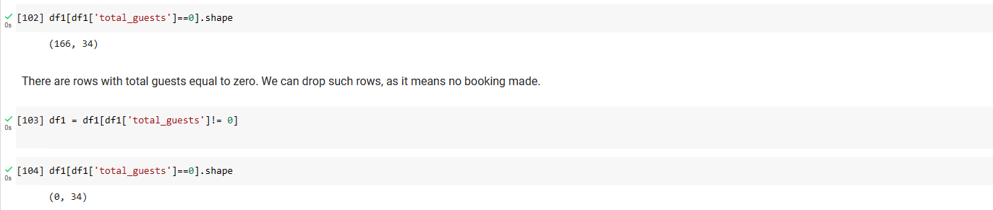
Data Wrangling: Creating New Columns
We have created two new columns total stay(sum of week nights and weekend nights) and total guests(sum of adults, children and babies).
Some rows in the dataset have a total guest count of zero, indicating that no booking was made. To clean the data, we can remove these rows from the dataset.

Slide 14
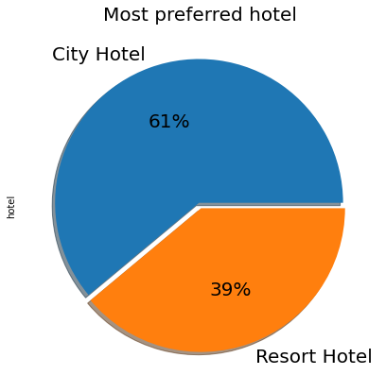
EDA: Most Preferred Hotel
It is observed that city hotel has a greater number of bookings compared to resort hotel. Here are a few potential insights that could explain this pattern:
Location: City hotels are often located in busy urban areas that are popular with tourists and business travelers
Price: City hotels may be more affordable than resort hotels, making them a more attractive option for travelers who are price-sensitive.
Availability: It's possible that the city hotel simply has more rooms available for booking than the resort hotel, which could explain why it has more bookings overall.

Slide 15
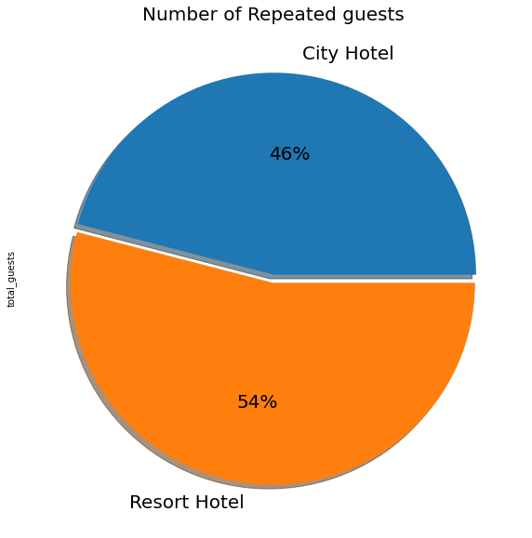
EDA: Repeated Guests
Resort hotel has more number of repeated guests compared to city hotel.
Vacation destination: Resort hotels are often located in popular vacation destinations, such as beach towns or mountain retreats.
Leisure travelers: Resort hotels tend to attract leisure travelers who are looking for a relaxing and enjoyable vacation experience.

Slide 16
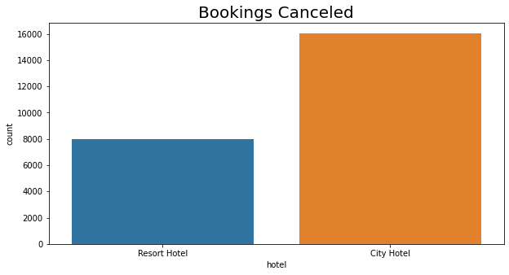
EDA: Bookings Cancelled
The resort hotel experiences fewer cancellations compared to the city hotel.
Out of the total 24,009 bookings that were cancelled, 16,035 belonged to the city hotel while 7,974 belonged to the resort hotel.

Slide 17
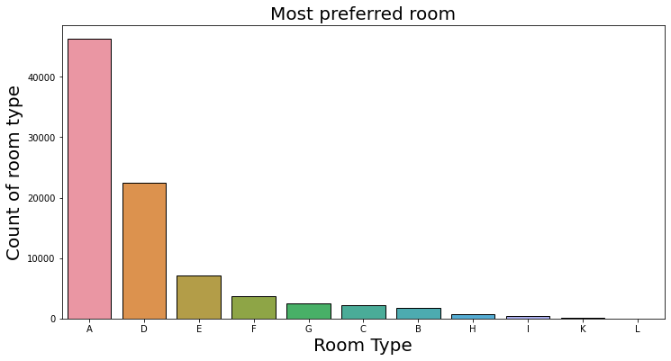
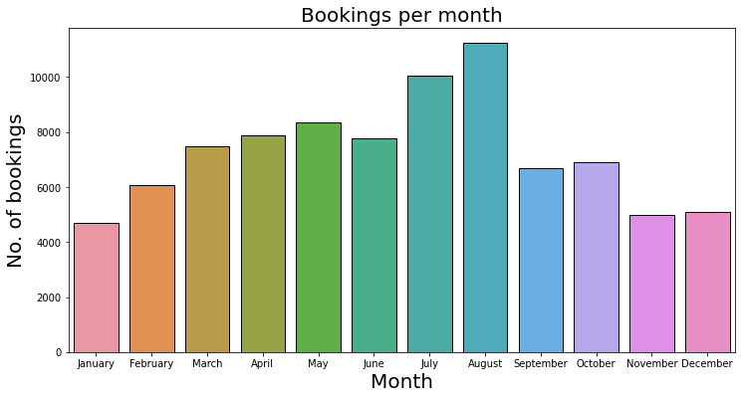
EDA: Room Type, Bookings Per Month
According to our findings, customers tend to prefer A type rooms the most, as evidenced by approximately 46,000 bookings.
On the other hand, D type rooms are the second most popular choice among customers, with a count of around 22,000.
August and July months has the greatest number of bookings with count around 11000.
On the other hand, January, November, December has a smaller number of bookings compared to other months.

Slide 18
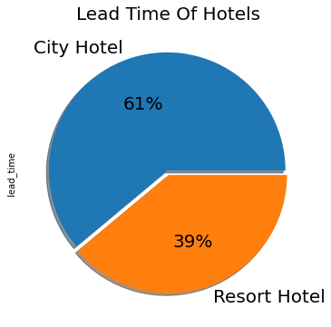
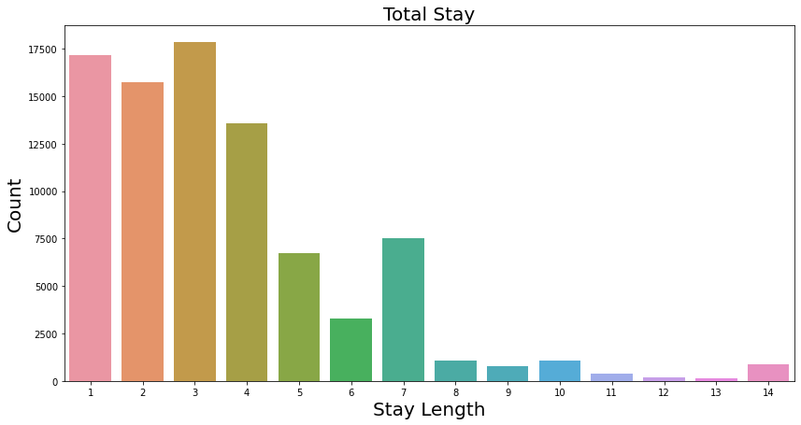
EDA: Lead time, Stay length
City hotels have longer lead time, which means that guests tend to book their stays further in advance. This is because city hotels are more popular and receive more bookings compared to Resort hotels.
Stays of less than 7 days are found to be the most preferred and favorable duration for booking a hotel.

Slide 19
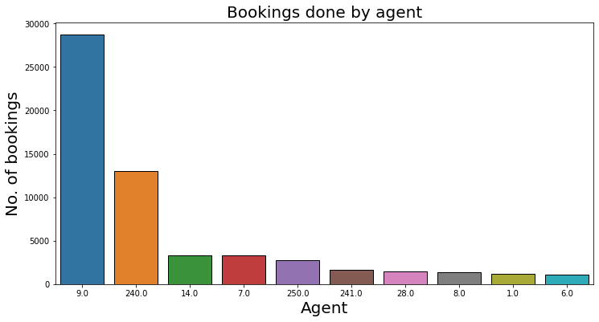
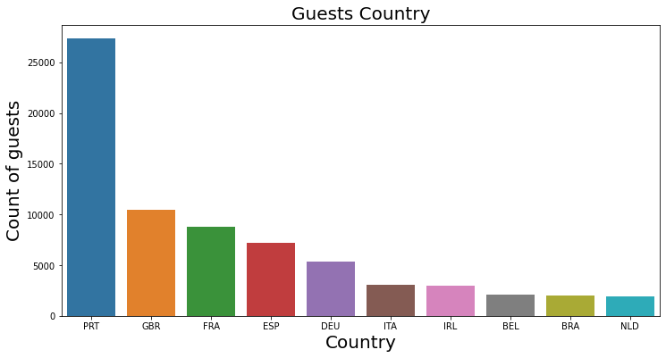
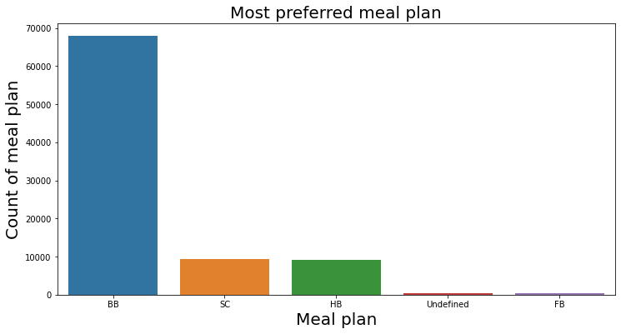
EDA: Agent, Meal plan, Country
Agent 9 secured the top position with over 28,000 bookings, while agent 240 holds the second position with approximately 13,000 bookings.
Out of all the meal plans, the Bed and Breakfast (BB) option is the most favored by customers.
The business is experiencing the highest influx of guests from Portugal.

Slide 20
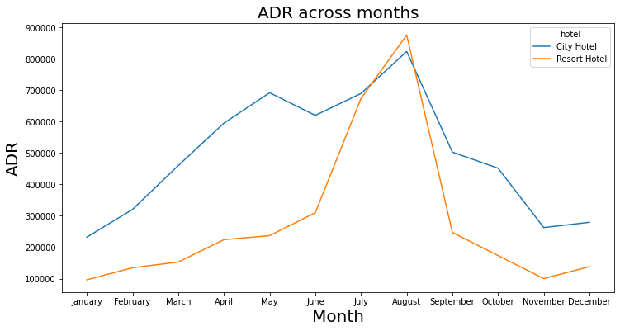
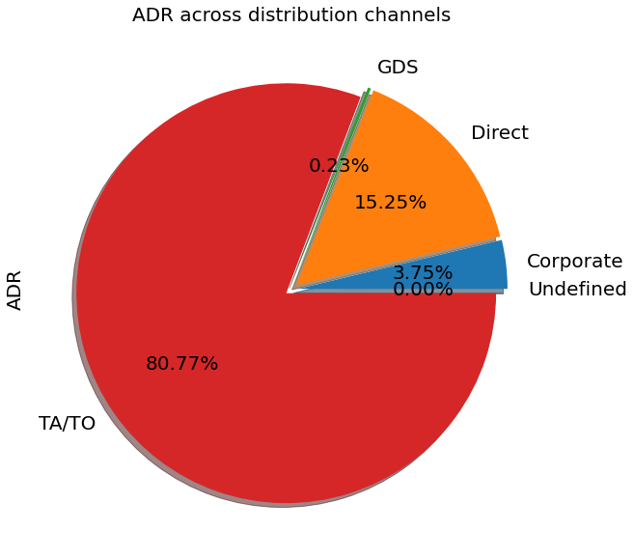
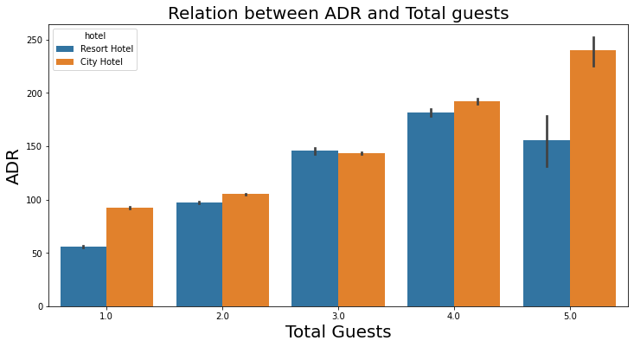
EDA: ADR
ADR experiences linear growth from June to August. However, the ADR is observed to be lower at the beginning and end of the year, which suggests a lower demand for hotel rooms during these periods.
ADR grows linearly with total number of guests.
Compared to other distribution channels, the Travel Agent/Tour Operator (TA/TO) channel has made a greater contribution to the ADR.

Slide 21
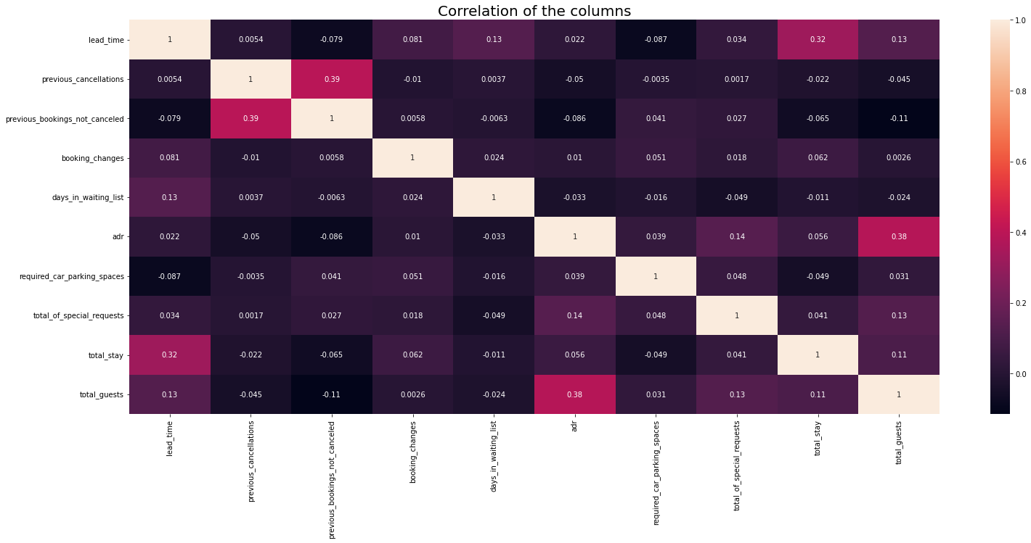
Correlation Heatmap
Correlation heatmaps are a type of plot that visualize the strength of relationships between numerical variables.

Slide 22
THANK
YOU

